Slide 1
Lawrence Technological University
Introduction
You will be using Matlab and Simulink for this project. You will be working in teams of 2. Each team will have two filters to design for their investigations. The 4 main filters are:
High pass
Low pass
Band pass
Notch
Two filters will be assigned for each group. Each group will have a combination of filters represented by:
High pass/Band pass
Low pass/notch

Slide 2
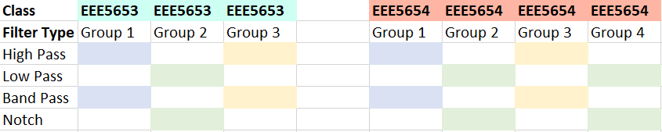
Filter Group Assignments

Slide 3
Objective
Overview
Develop a Simulink model using the appropriate blocks to include a signal generator, filter design, and oscilloscope.
From the model you generate in Simulink, you will record amplitude and frequency data from the Simulink scope block as you vary the frequency in your model in the signal generator block.
You will vary the frequency in the signal generator block and record the amplitude changes from the scope block. Record the input and output amplitudes. For example, try changing the frequency every 10 KHz and record the amplitudes.
Construct a second model using a pulse generator, filter design, and spectrum analyzer.

Slide 4
Methods for Model 1
Design a filter for each of the two filters assigned per group.
Low pass/High pass
Bandpass/Notch
Characterize
Oscilloscope
Data capture
Vary the frequency from the Simulink sine wave block.
Capture the amplitude of the sine wave in the oscilloscope from the varying frequency.
Configure these scope parameters for logging the signal to the Matlab workspace/file.
Calculations
Calculate the frequency response by calculating (output amplitude/input amplitude) in dB.

Slide 5
Methods for Model 2
Design a filter for each of the two filters assigned per group.
Low pass/High pass
Bandpass/Notch
Characterize
Spectrum Analyzer
Pulse generator
Create a Dirac pulse to input into the filter.
Note: Look at the Simulink pulse generator and the step response block for ways to create a Dirac signal.
Calculations
Details for requirements for the data capture and calculations will be presented for next Tuesday’s class.

Slide 6
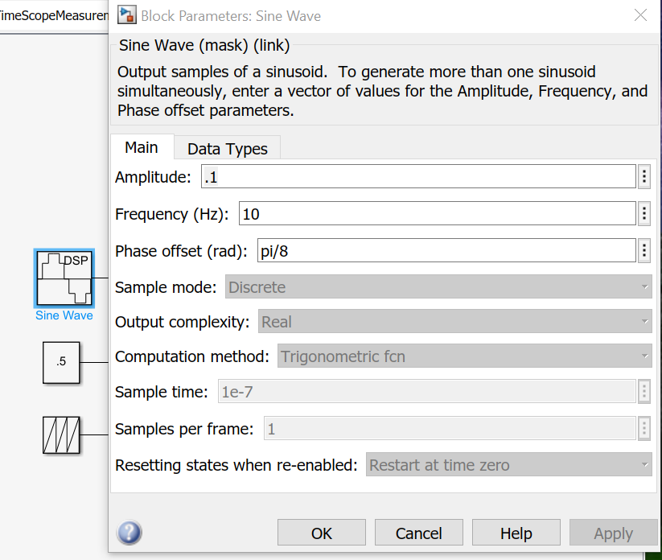
Sine Wave Block
One idea you could try for adjusting the frequency for your sine wave block is to set the internal frequency of the sine function to 1 then multiply the input signal by the desired frequency. Another idea is to vary the frequency by feeding in a ramp to the sine block.
In time-based mode, the value of the sample time parameter determines whether the block operates in continuous mode or discrete mode.
Please refer to the MathWorks documentation for the Sine Wave block for more information.

Slide 7
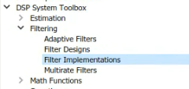
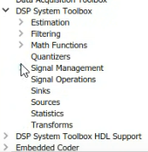
Filter Design App/Simulink Block
Matlab command:
>> filterDesigner
Simulink block:
Open Simulink
Navigate to the DSP System Toolbox
Select Filtering - filter implementations
Choose the Digital Filter Design Block from the list.

Slide 8
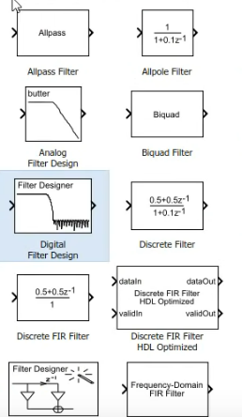
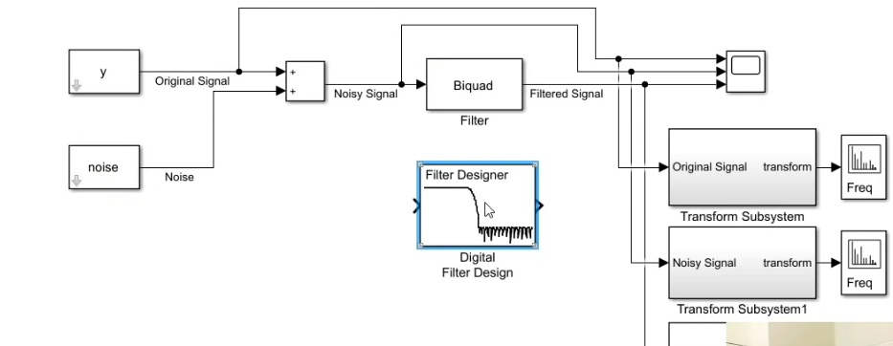
Filter Design App/Simulink Block
Drag into the model you are creating

Slide 9
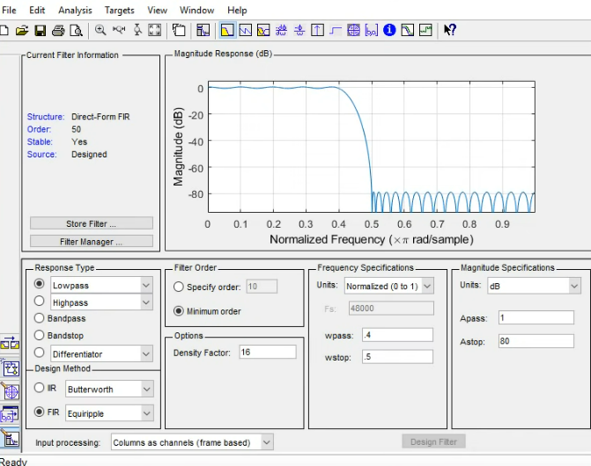
Filter Design App/Simulink Block
Open the block to see the filter designer app

Slide 10
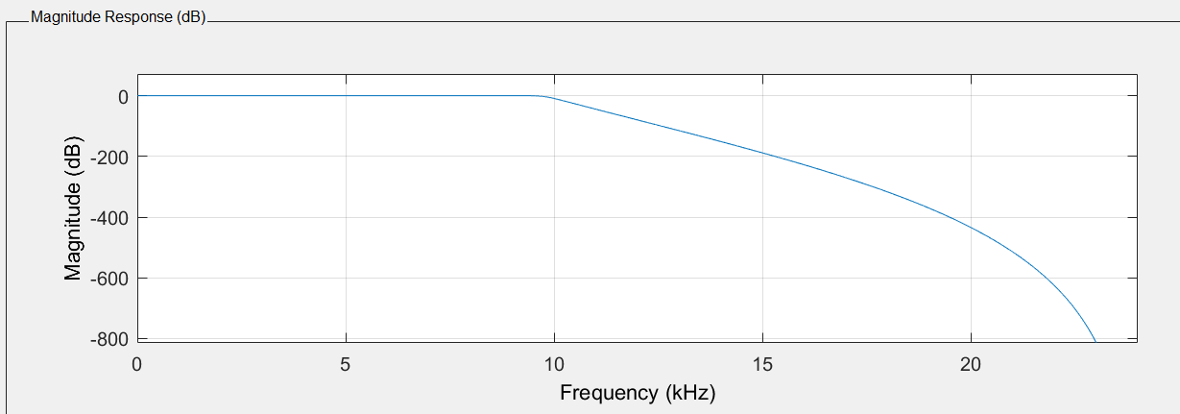
Some Filter Design App Features
Once you generate a signal from the signal generator you can connect this block to a scope block and look at the plot to see what frequencies to attenuate.
From here you can find the sampling frequency and the cut-off frequencies for your filter design. By using the filter designer, several plots are available for you to see how your filter is performing.
Magnitude response:

Slide 11
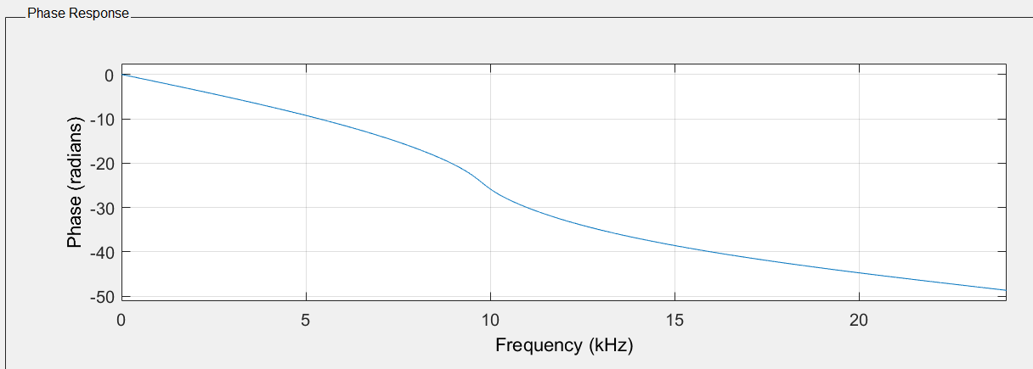
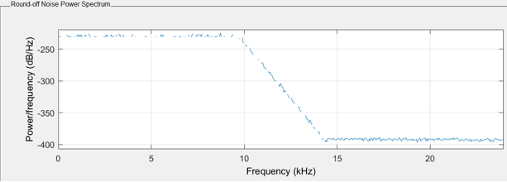
Some Filter Design App Features
Phase response:
Round-Off Noise Power Spectrum:

Slide 12
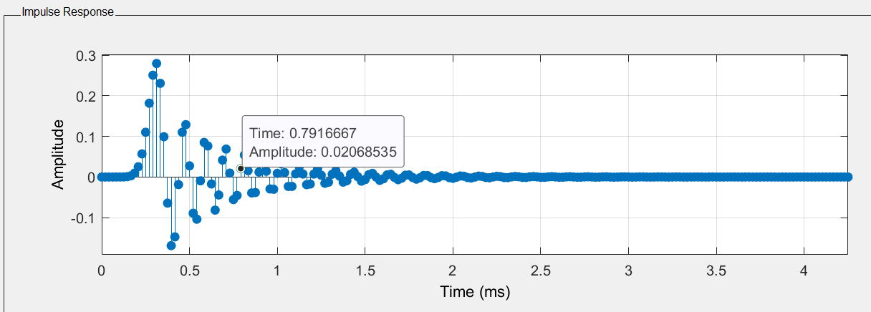
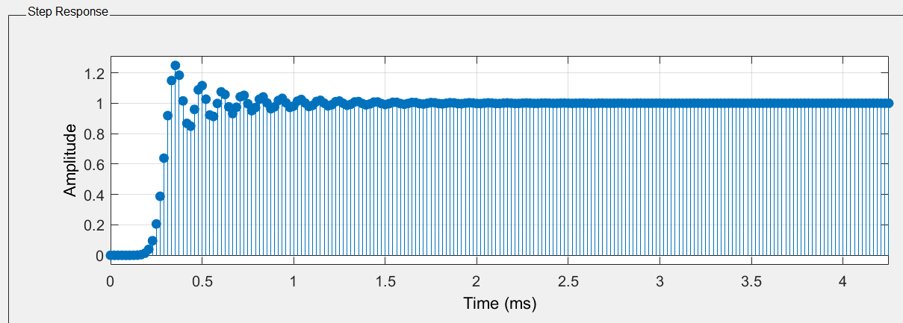
Some Filter Design App Features
Impulse response:
Step response:

Slide 13
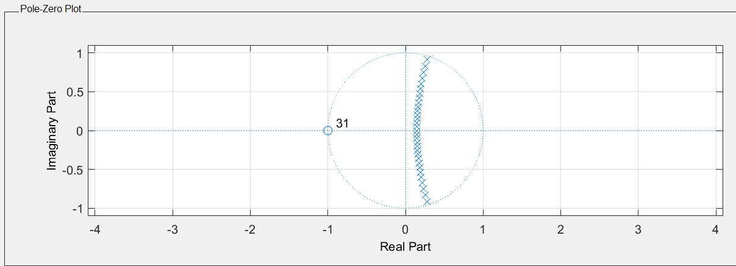
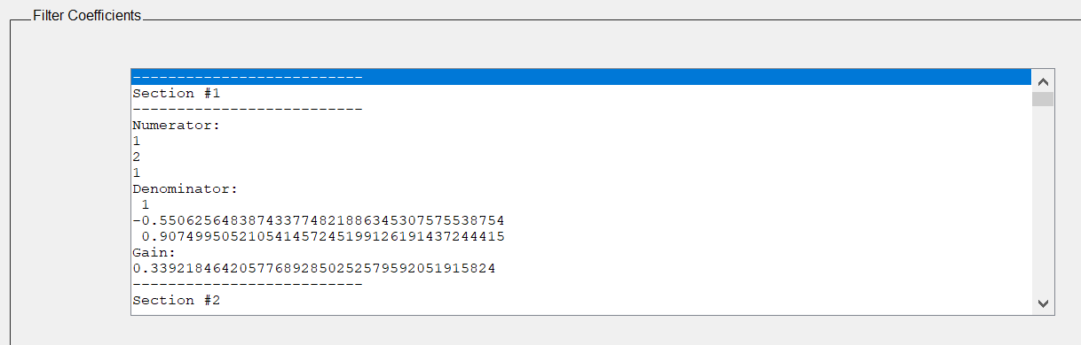
Some Filter Design App Features
Pole-Zero Response:
Filter Coefficients:

Slide 14
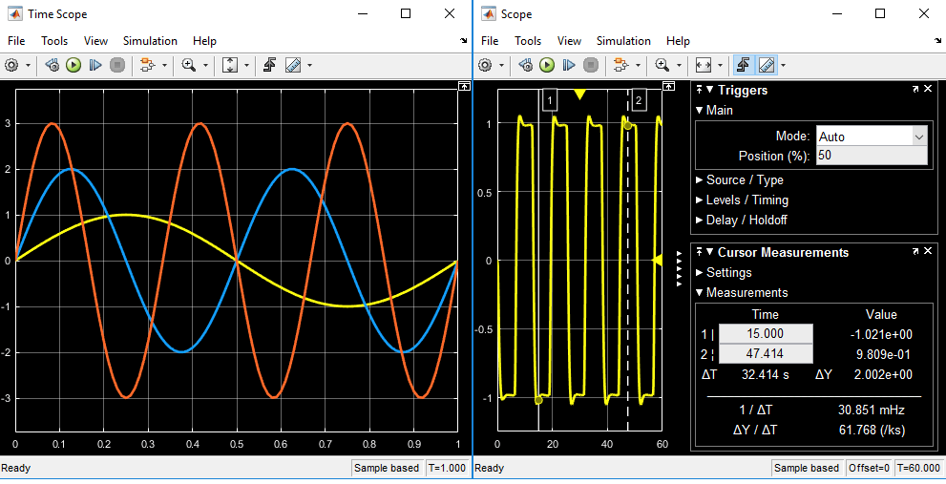
Scope
The Simulink scope block and the DSP System Toolbox time scope block have identical functionality but they have different default settings. The Time Scope is optimized for discrete time processing. The scope is optimized for general time-domain simulation.
You can measure signal values using vertical and horizontal cursors. See MathWorks documentation for more details.

Slide 15
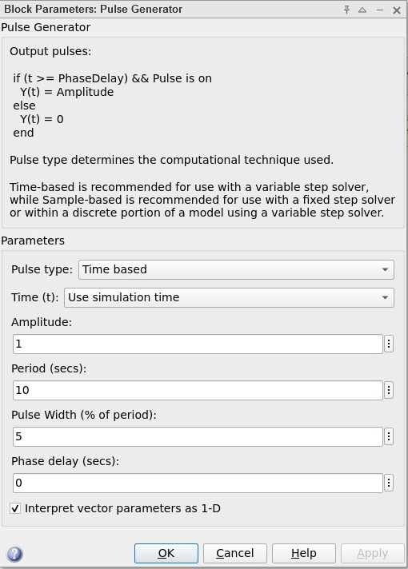

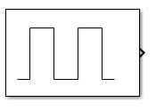
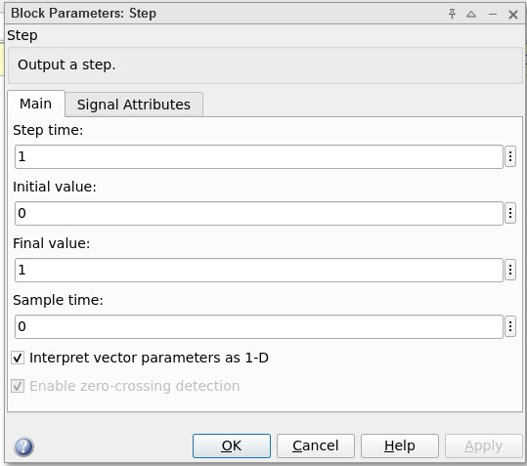
Pulse Generator and Step Function
Some possibilities to investigate to create a Dirac.
Step Function
Pulse Generator

Slide 16
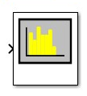
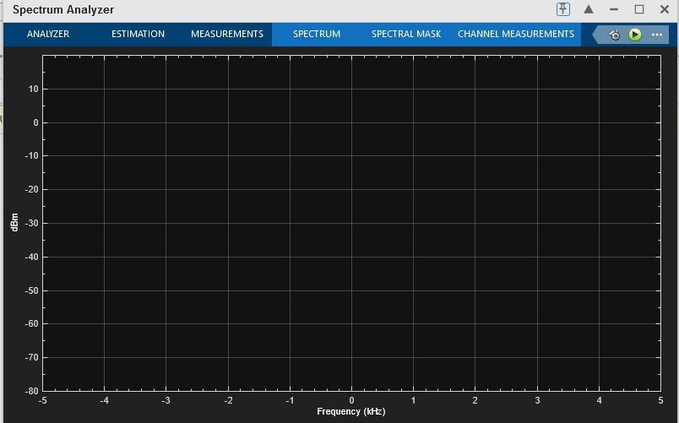
Spectrum Analyzer

Slide 17
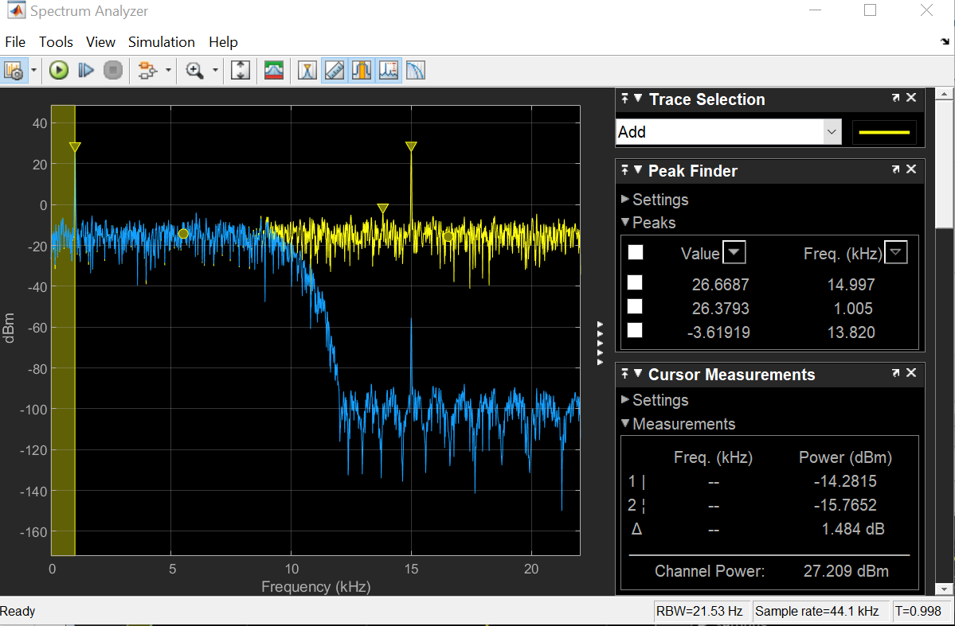
Spectrum Analyzer
Settings view in the spectrum analyzer

Slide 18
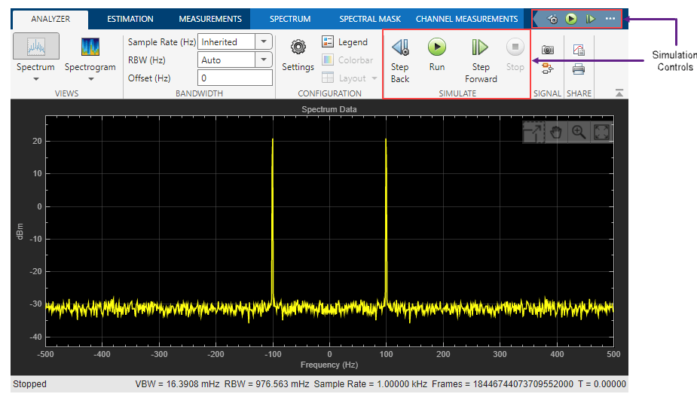
Spectrum Analyzer

Slide 19
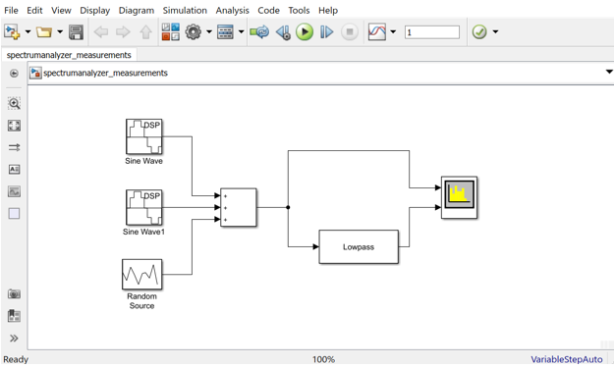
Simulink DSP Project Wrap-up

